Slide 1

Foundational Model for NMR Metabolomics
Group Meeting 27th Feb 2026
Shankararama Sharma

Slide 2
Goal
Build a Foundational model for NMR Metabolomics data
Why?
To classify normal vs abnormal or similar data
Maybe help in finding Biomarkers
What are solving?
Deep Neural nets (DNNs) require lots of data to train.
Metabolomic datasets are usually very small 10s or 100s of samples
Notes:
Foundational model for 1D NMR metabolomics data. To be able to classify downstream tasks where data is limited.

Slide 3
Masked Spectra Modelling (MSM)
Task: hide 15–50% of ppm bins (scattered), reconstruct them.
Why it helps later?
Forces model to learn multiplet shapes, J-patterns, and baseline behavior.
Yields features that generalize to tiny labeled sets (disease/control).
Acts as a regularizer during fine-tuning (less overfitting).
Loss (simple & strong):
MSE on Masked (0.7) + Unmasked (0.3)

Slide 4
Flow

Slide 5

Data Download
Metabolights
Contains CPMG and NOESY spectra of many experiments from across the world
Separated them into – Serum and Plasma
Total 2146 usable CPMG Serum spectra

Slide 6
Preprocessing
Process all the spectra on TopSpin
Serial processing - lb 1; si 2*td; em; ft; apk
This usually makes all the spectra 128k points long
Read all the bruker ‘fid’ files using nmrGlue
Find the rightmost peak and align spectra using that as reference
Water suppression: points 62500 – 68000 made equal to zero
Remove duplicated spectra
Normalise intensities to between 0-1
Notes:
Add images here for better visualisations

Slide 7
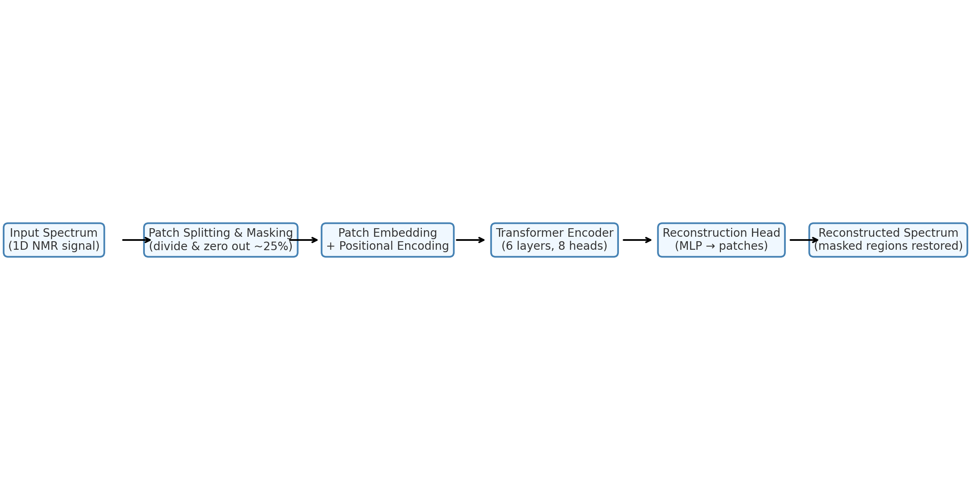
Model Architecture

Slide 8
Performance on Train Data
Metric | 25% Mask | 35% Mask | 50% Mask
Overall MSE | 3.28×10−5 | 3.18×10−5 | 5.04×10−5
Overall R2 | 0.9805 | 0.9813 | 0.9695

Slide 9
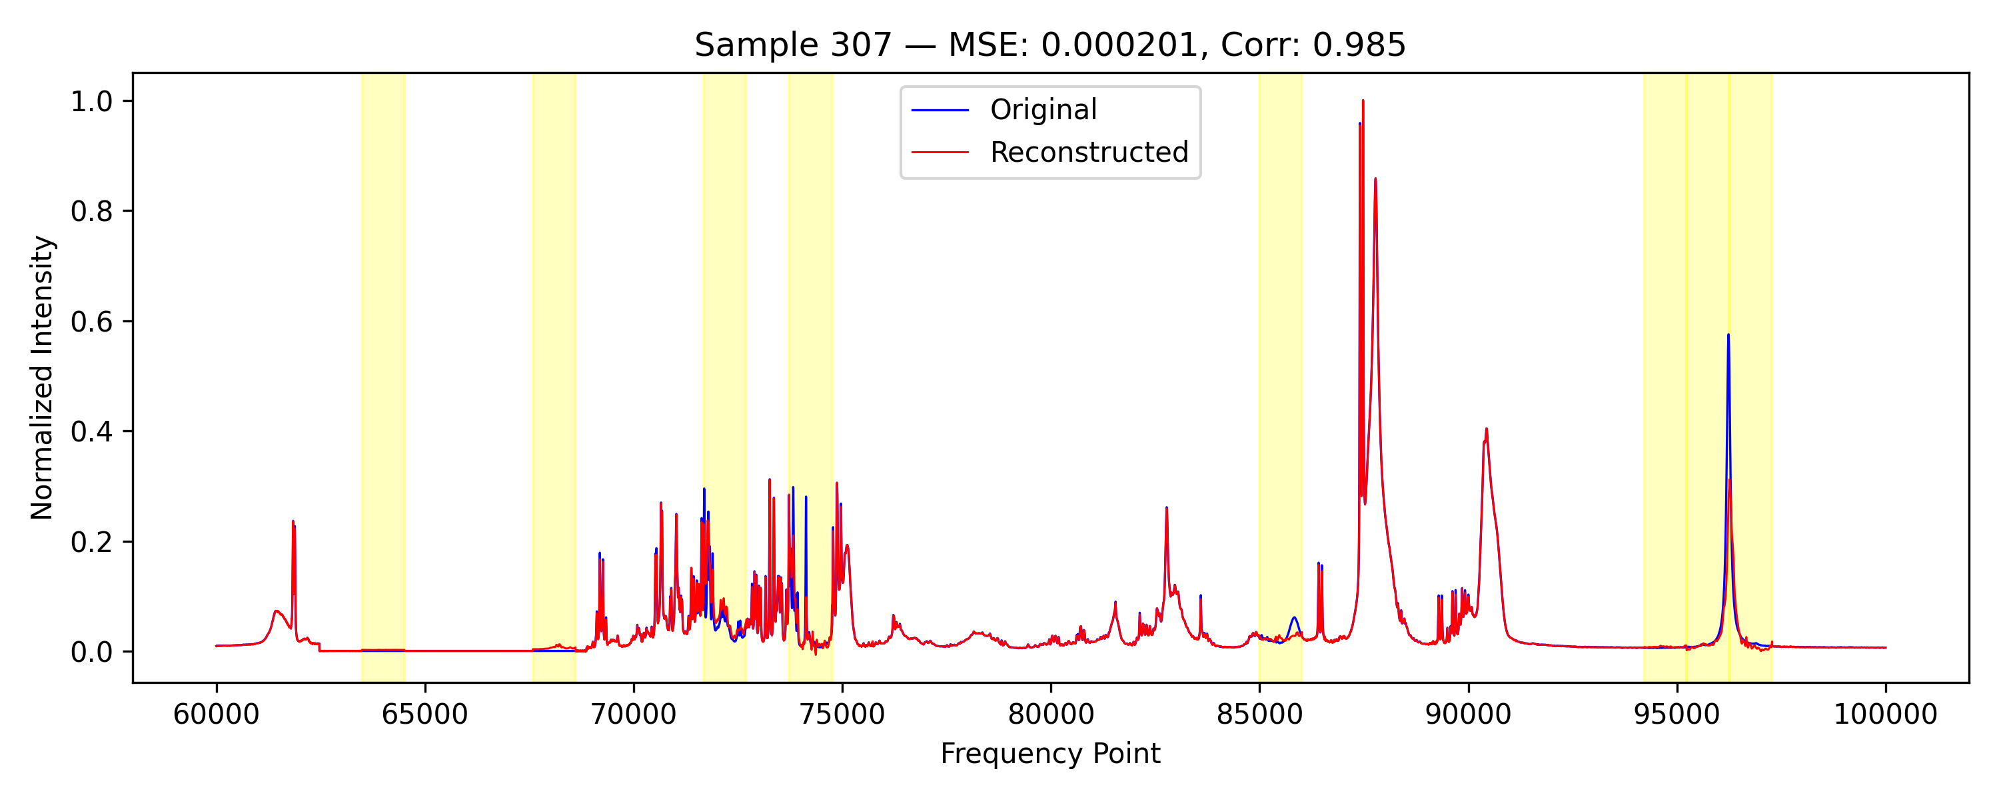
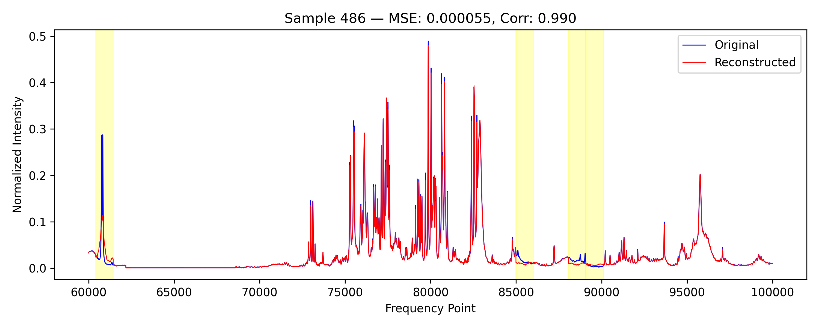
15% Masking

Slide 10
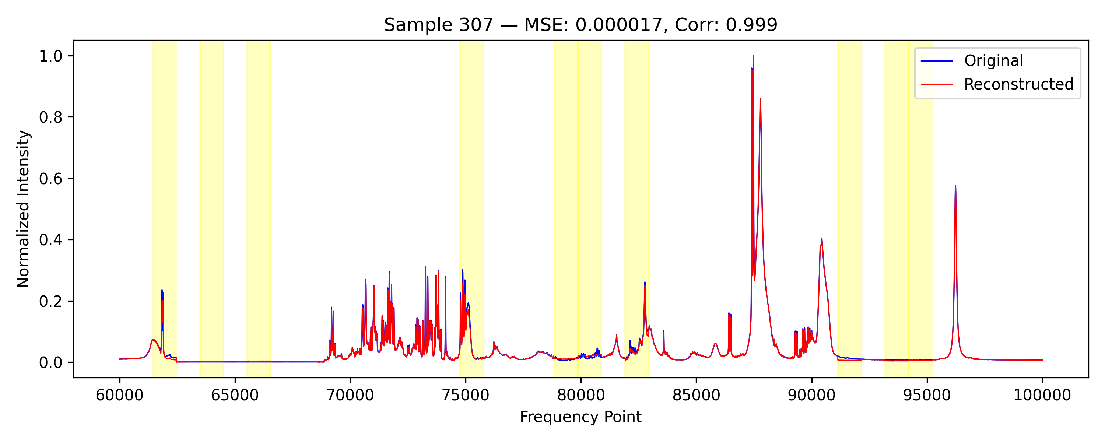
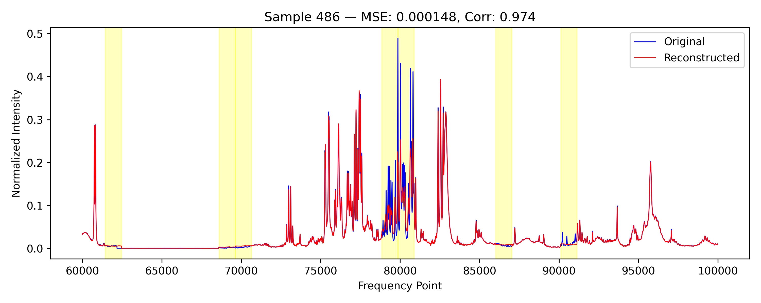
25% Masking

Slide 11
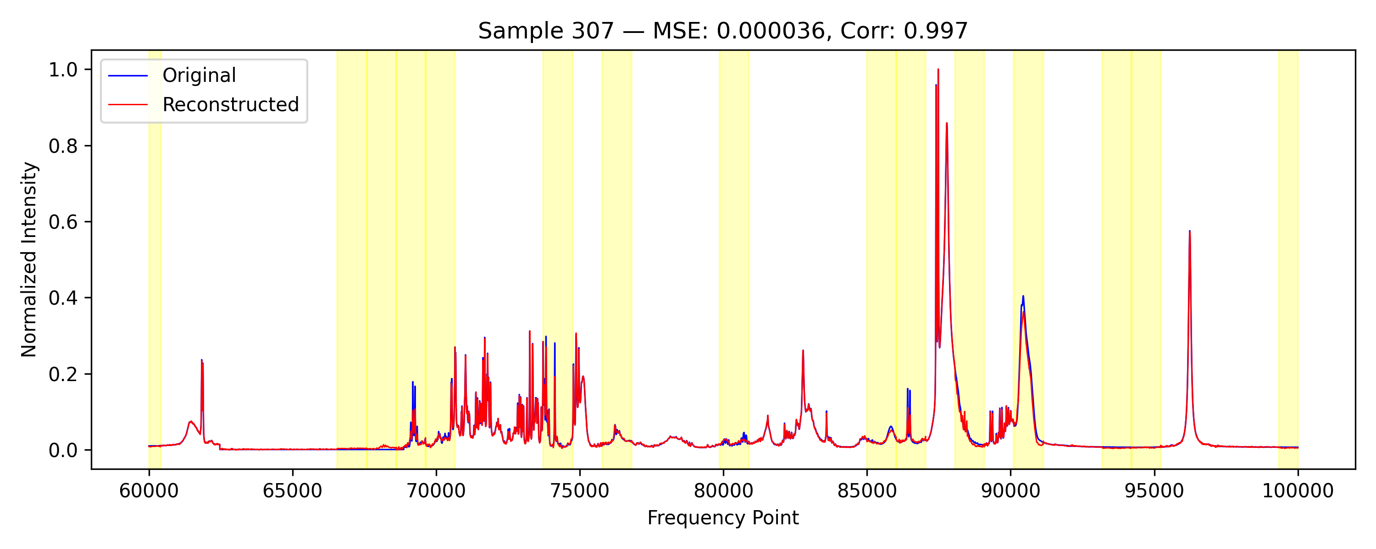
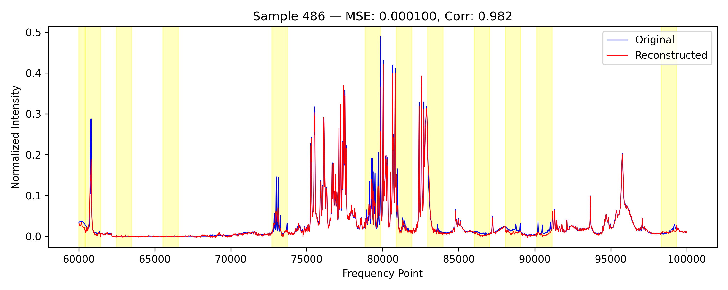
35% Masking

Slide 12
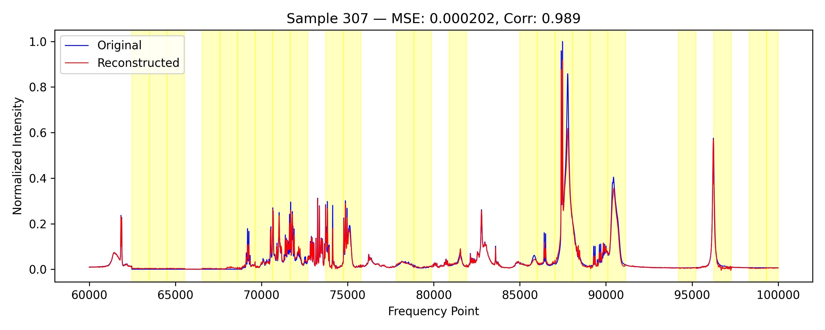
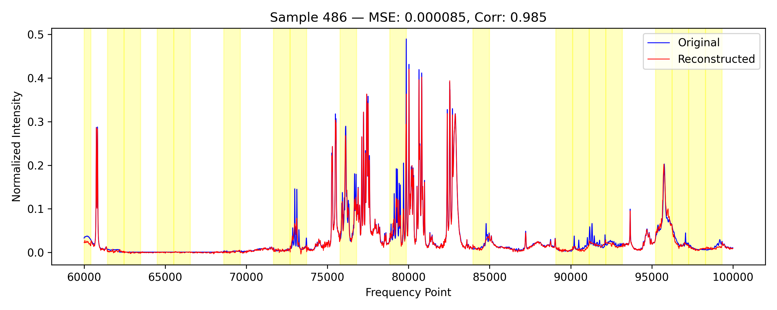
50% Masking

Slide 14
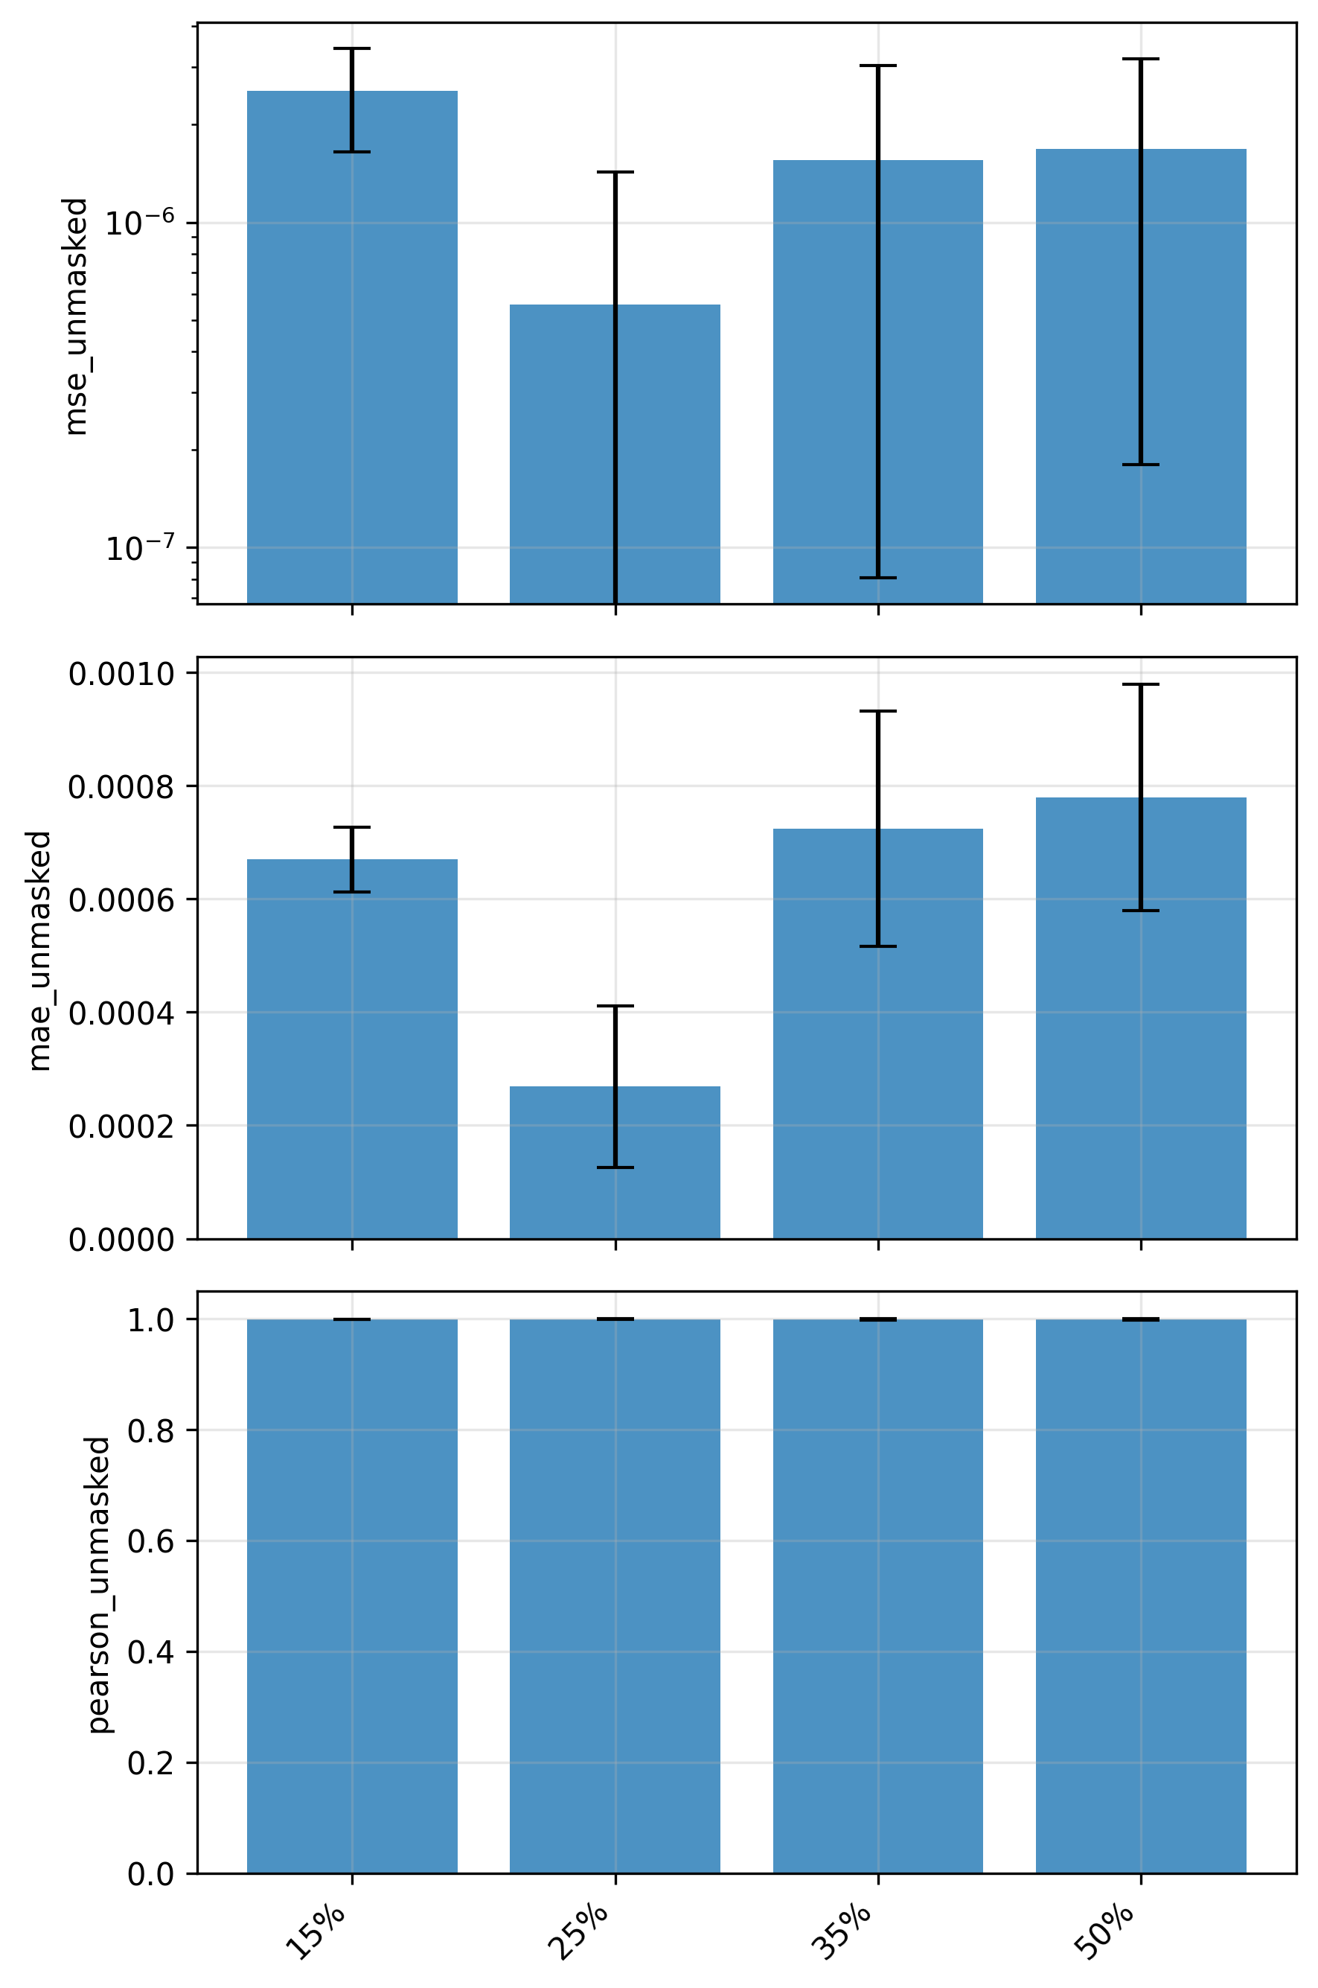
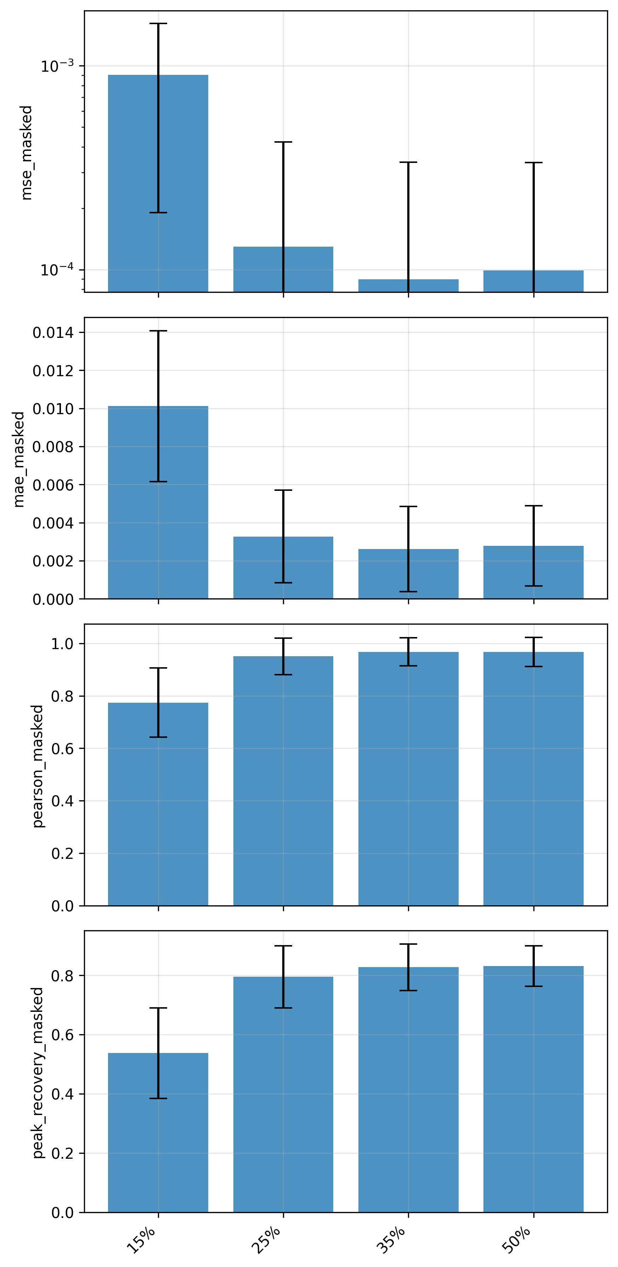
Comparison of Unmasked and Masked regions
Unmasked
Masked →

Slide 15
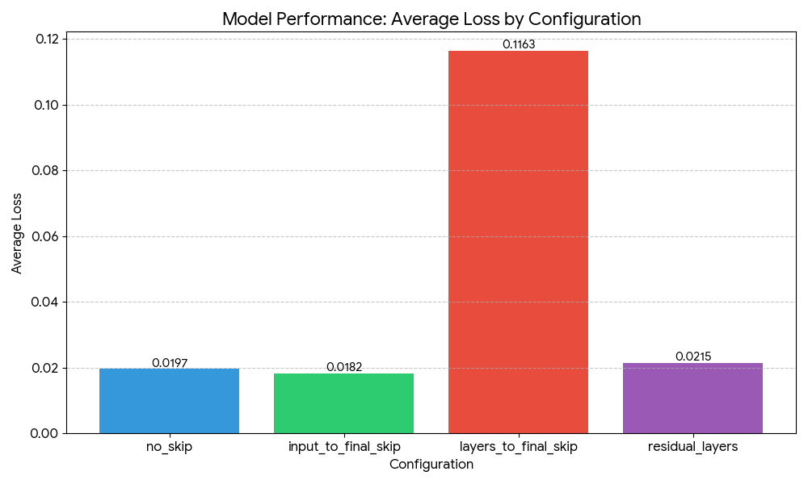
Gradient Analysis

Slide 16
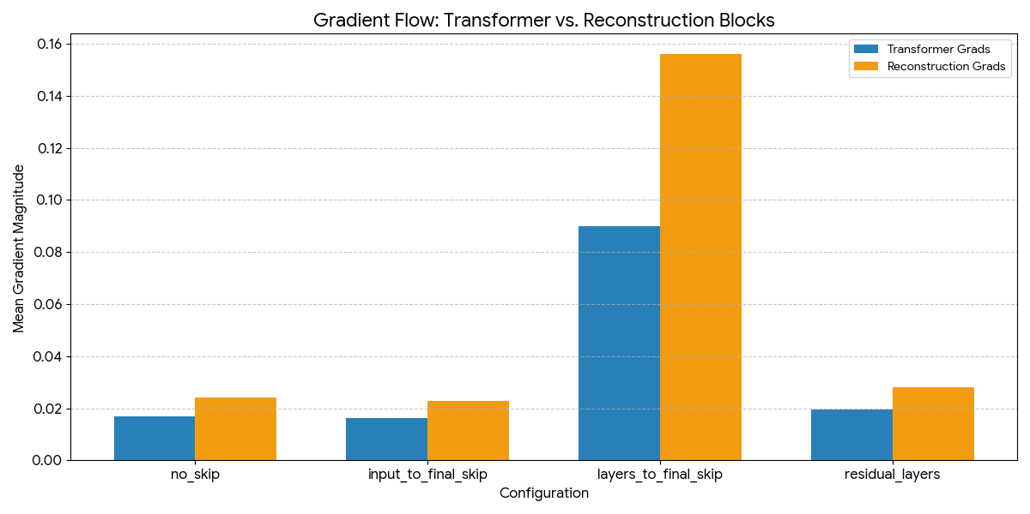

Slide 17
Test Data
Traumatic Brain Injury (TBI) samples from Tirupati (thanks to Gayatree)
CPMG Serum
~57 samples
Collected on 1st Day and 4th Day

Slide 18
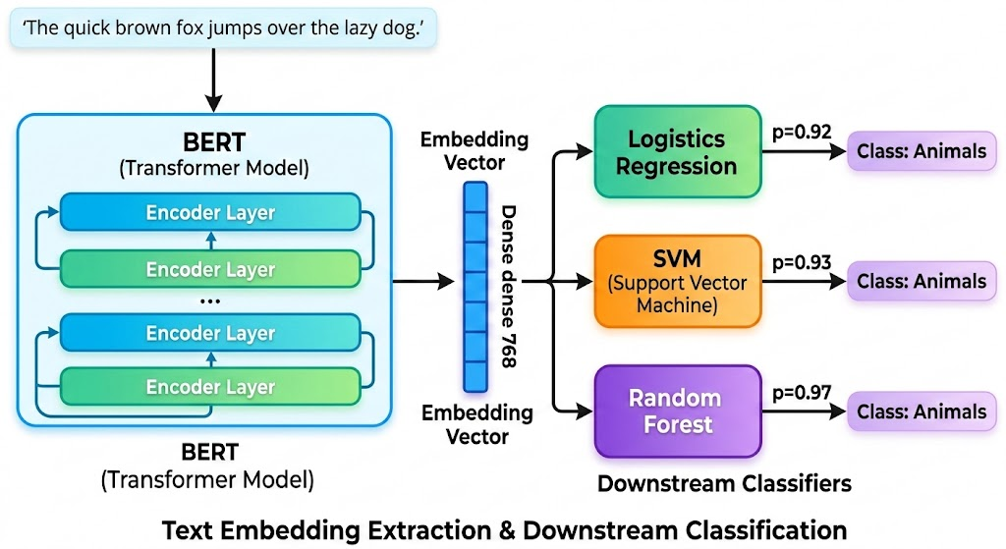
Test 1 – Backbone + ML Model
Three models – SVM, Logistic Regression, XGBoost
Extract embedded features from our trained model (128)
Feed into these 3 ML models
Try to classify – using Cross Validation

Slide 19
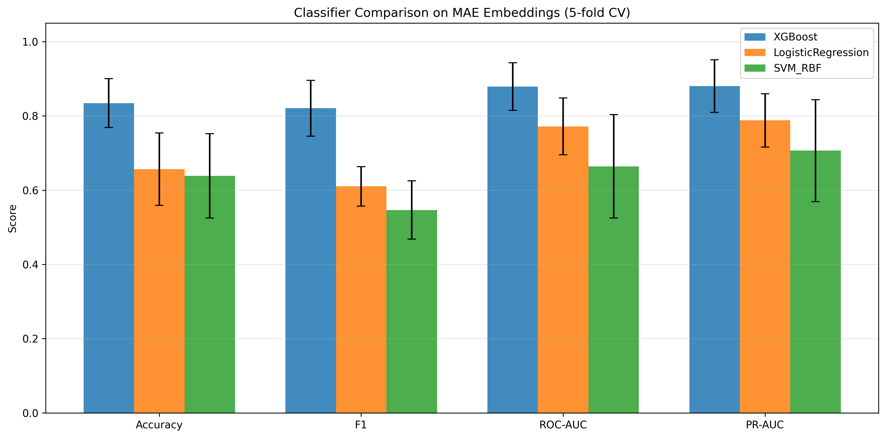
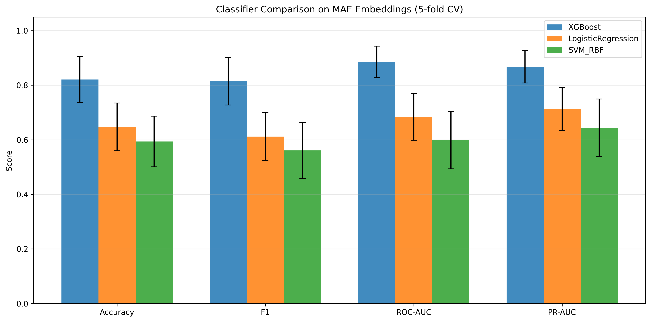
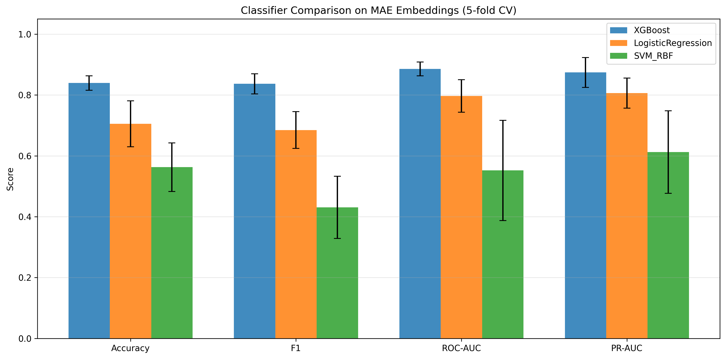
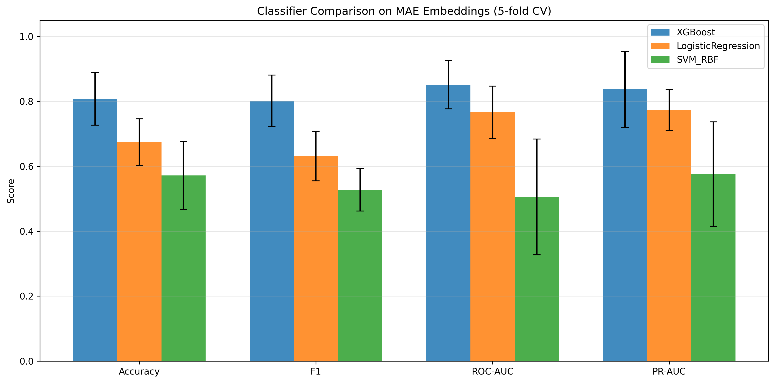
Comparison of 15%, 25%, 35% and 50% Masking – ML Models trained on Embeddings
15%
25%
35%
50%

Slide 20
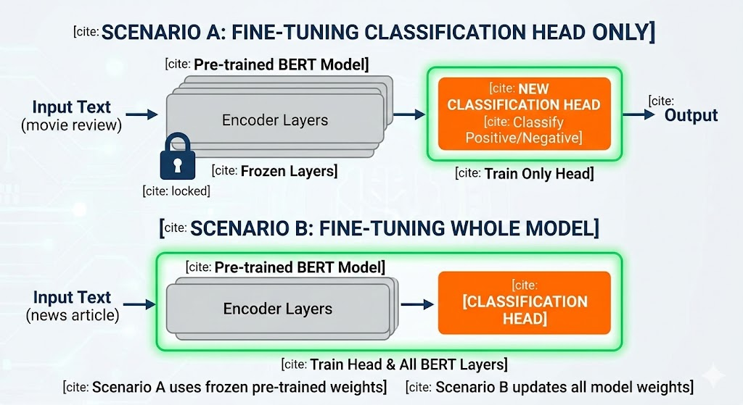
Test 2 – Backbone + Classification head
Change the final layer of our DNN
Make it a classification head
Two methods
Freeze the backbone
Finetune backbone also
Try to classify – using Cross Validation

Slide 21
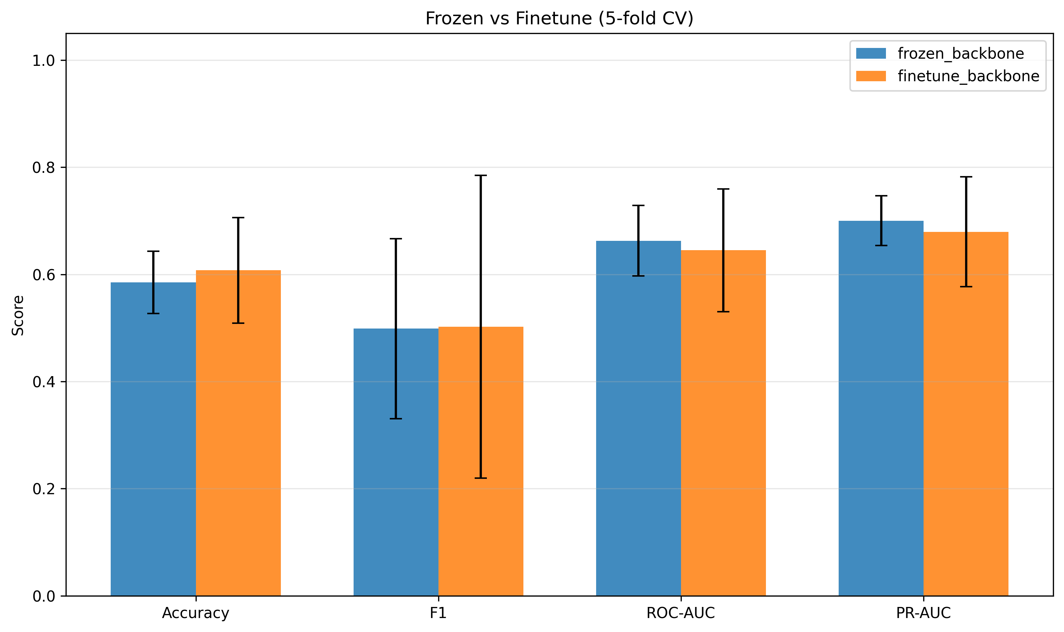
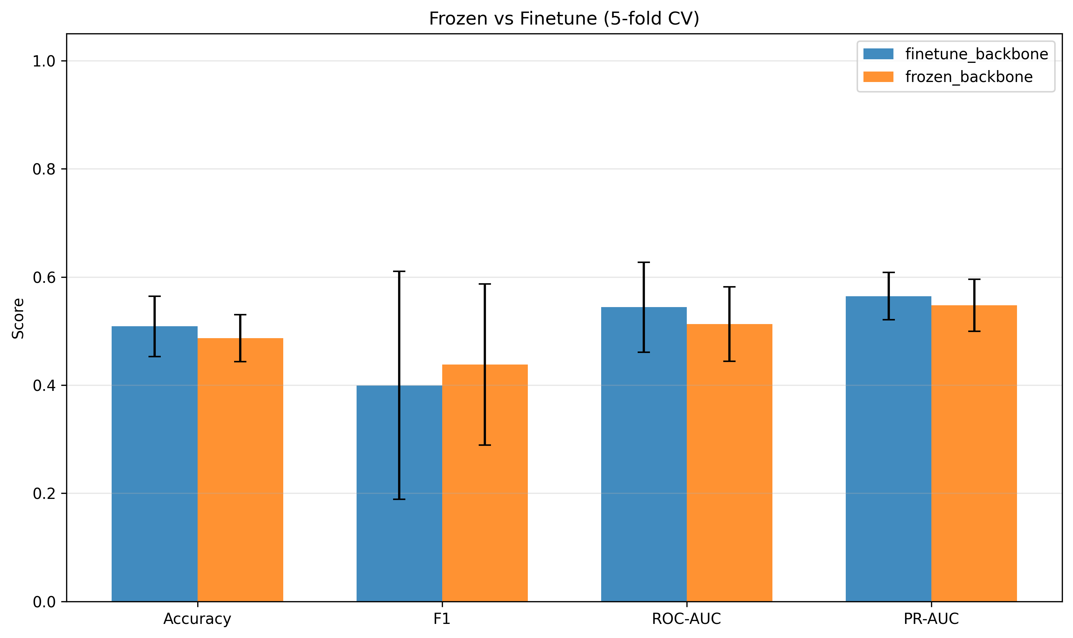
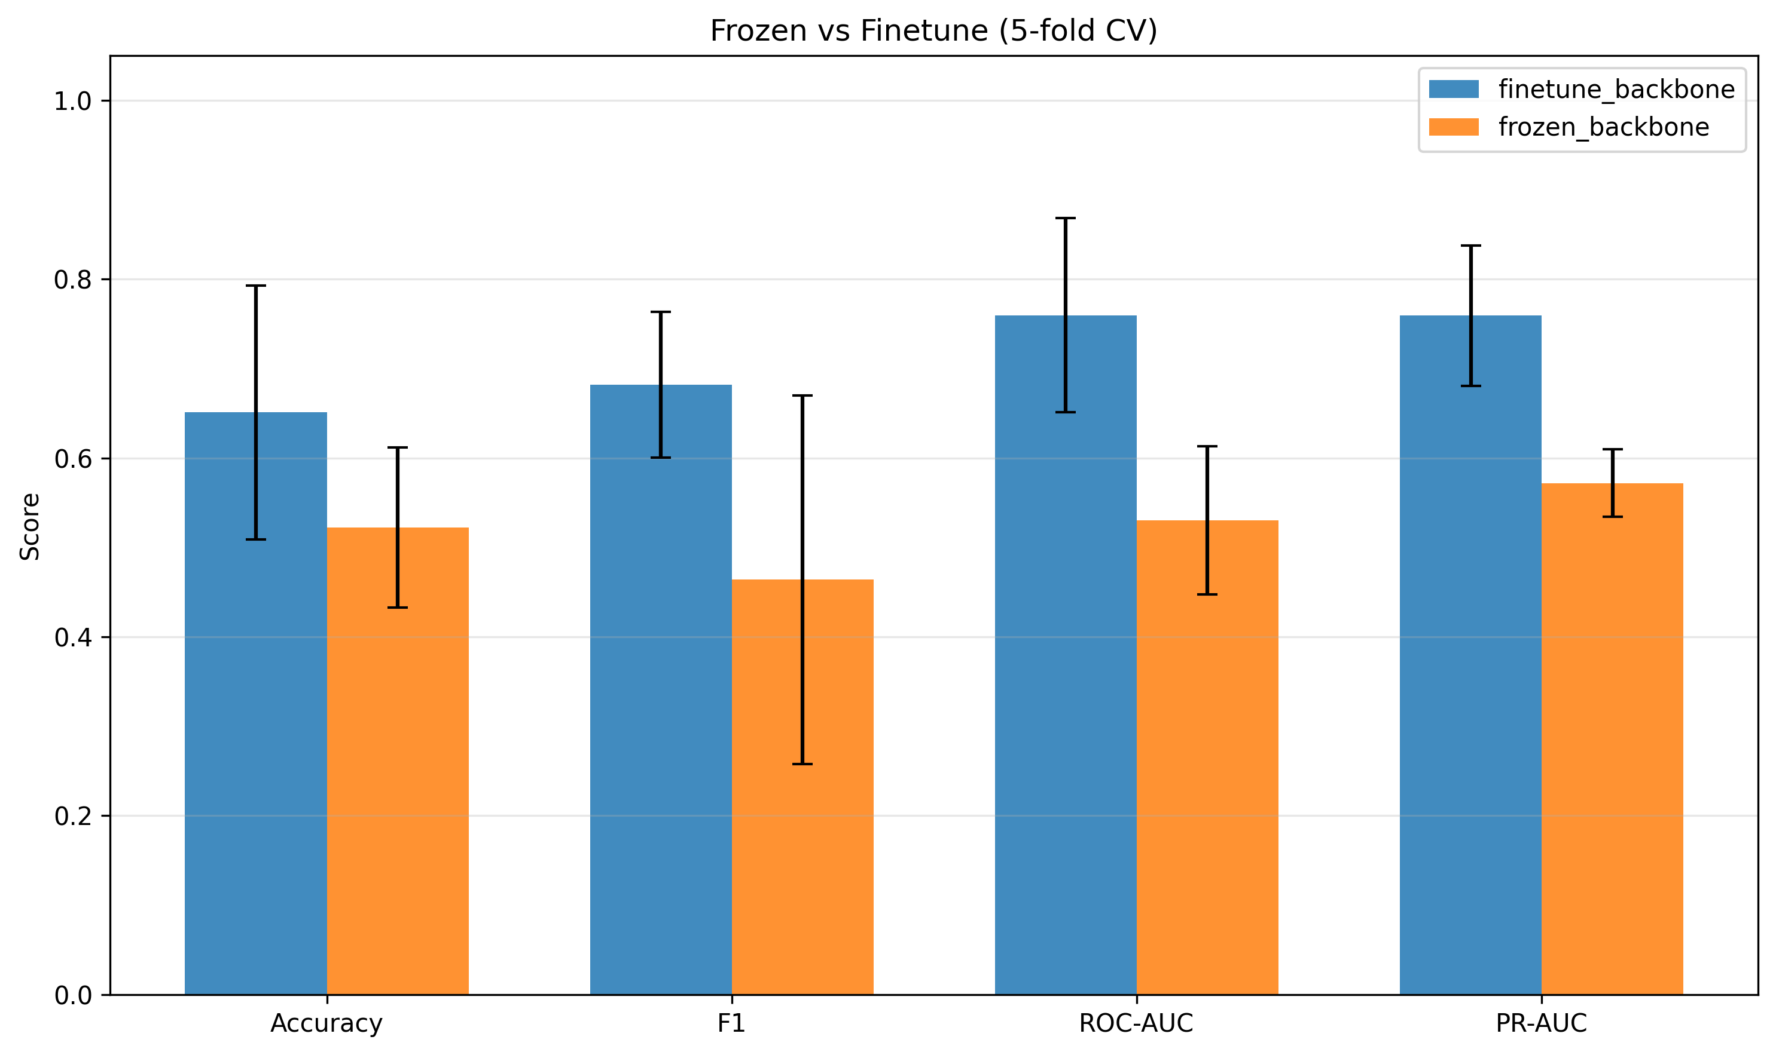
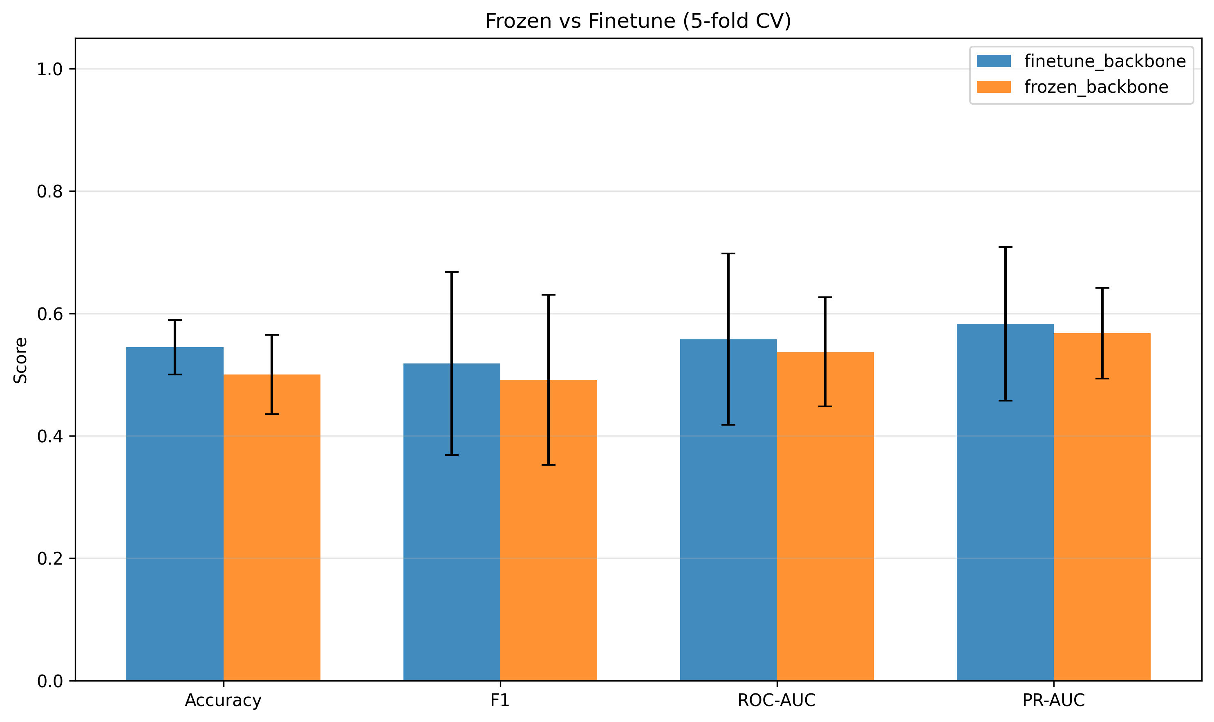
Comparison of 15%, 25%, 35% and 50% Masking – Frozen Backbone vs Finetuning
15%
25%
35%
50%

Slide 22
Test 3 – Only ML models
Bin the spectra into 128 or 256 bins
Use the 3 ML models directly
AUC values for each bin to be fed
Try to classify – using Cross Validation

Slide 23
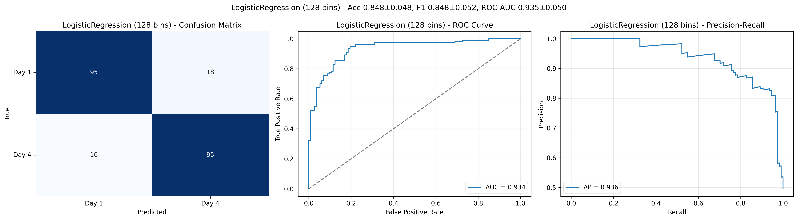

Logistic Regression – 128 and 256 bins

Slide 24
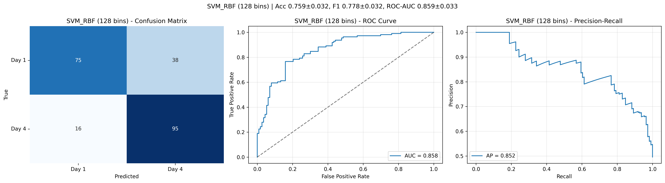
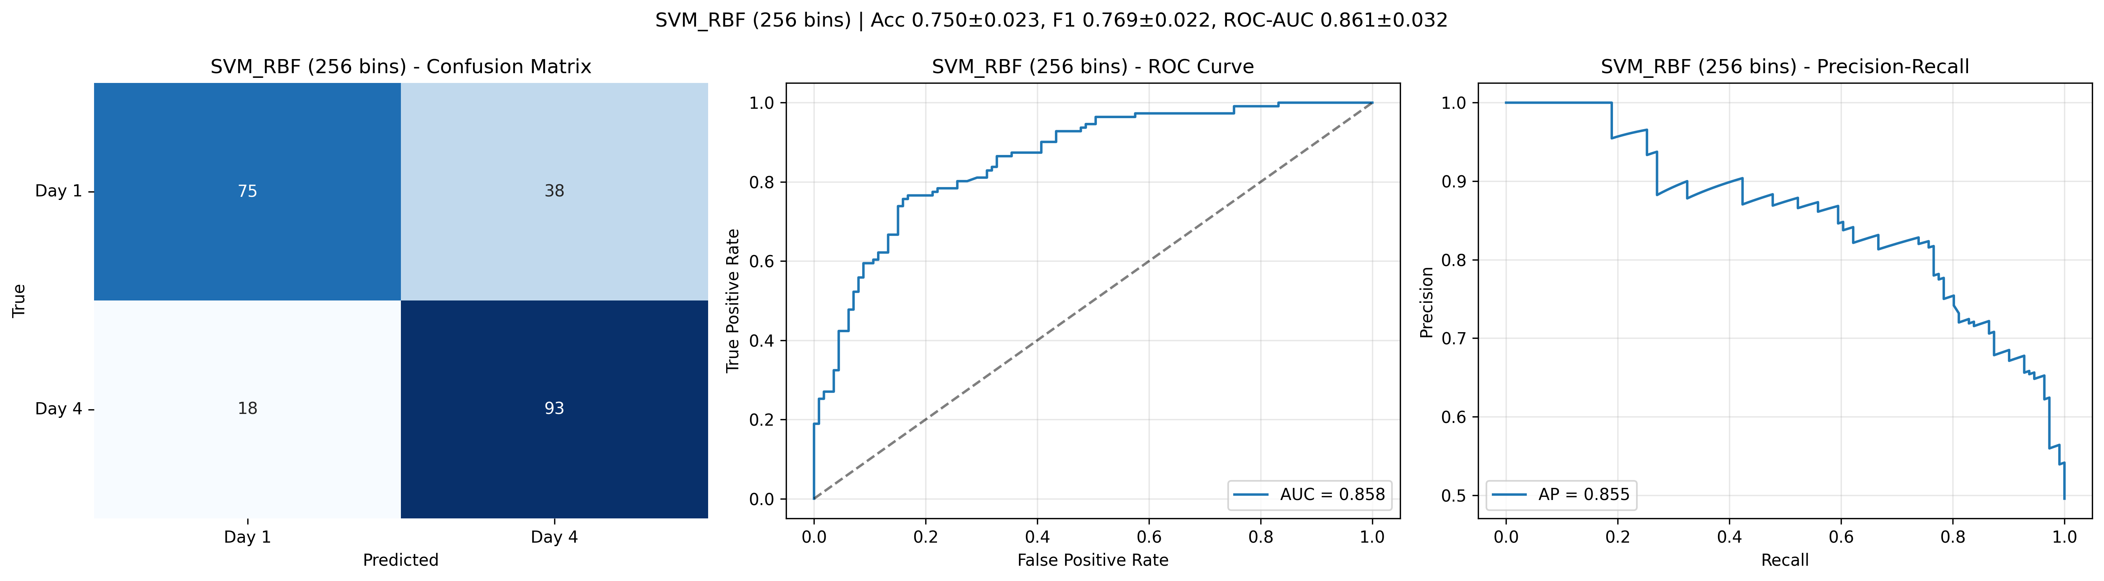
SVM – 128 and 256 bins

Slide 25
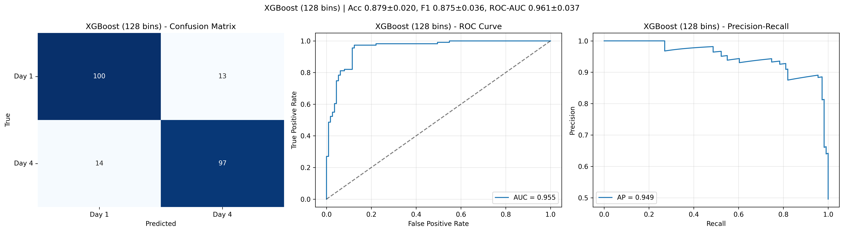
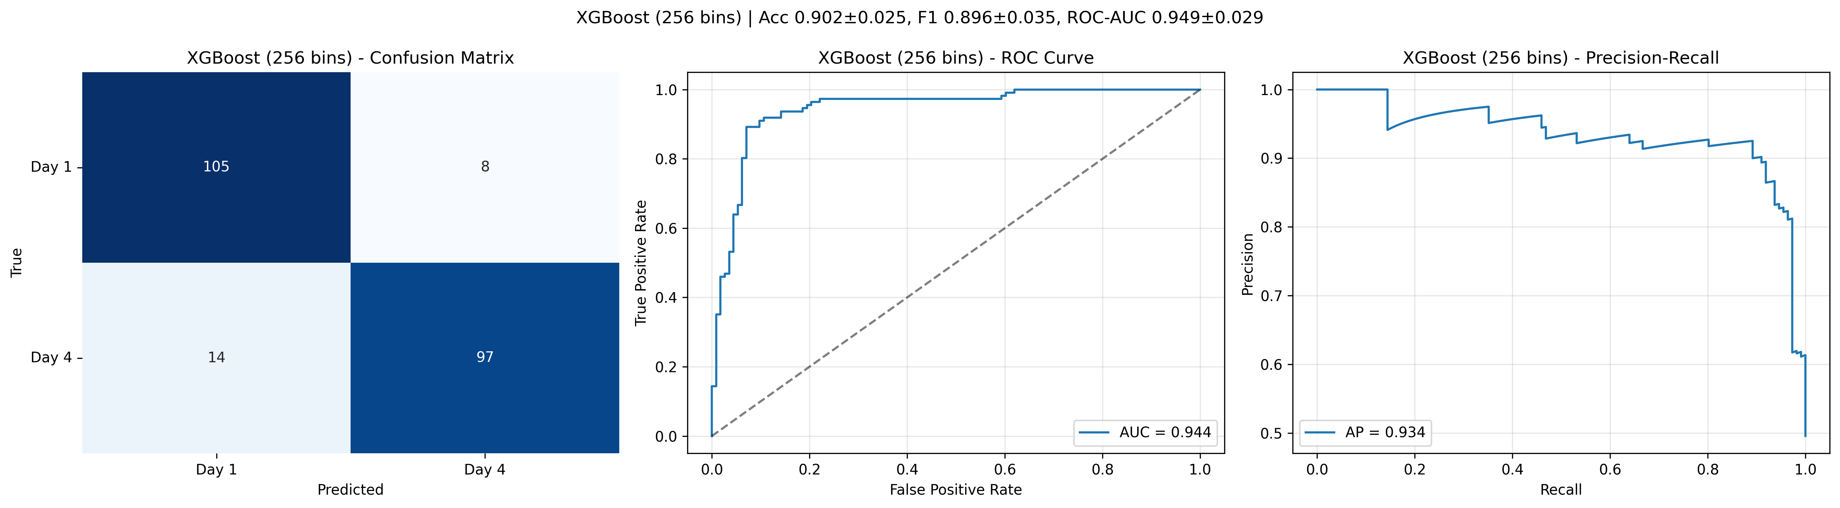
XGBoost – 128 and 256 Bins
Notes:
Check this ony on CPMG short or only on CPMG long
Have they been filtered? For lipid and big molecules. Cut out 0.7 ppm to 1.4 ppm and try
Which bins are most important? - analysis

Slide 26
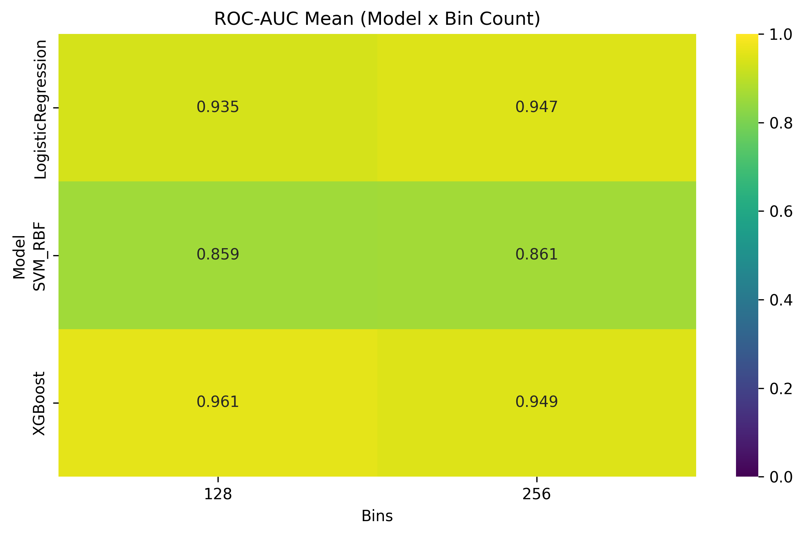

Slide 27
Thank you all!!
Notes:
EDTA or heparin tubes

